Slide 1
Association Rule Mining

Slide 2
Frequent Pattern Analysis
Frequent pattern
a pattern (a set of items, subsequences, substructures, etc.) that occurs frequently in a data set
Motivation: Finding inherent regularities in data
What products were often purchased together?
What are the subsequent purchases after buying a PC?
What kinds of DNA are sensitive to this new drug?
Can we automatically classify web documents?
Notes:
Applications
Basket data analysis, cross-marketing, catalog design, sale campaign analysis, Web log (click stream) analysis, and DNA sequence analysis.

Slide 3
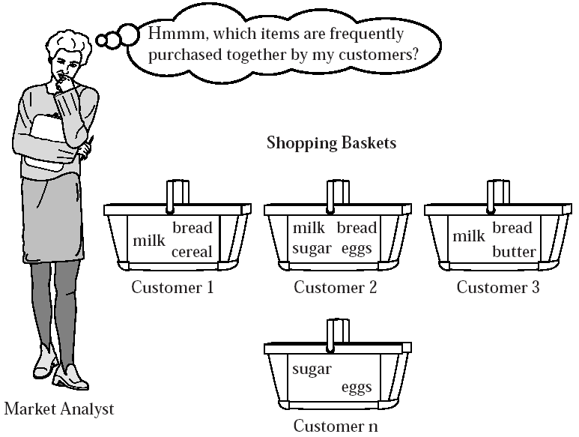
Association Mining
Association rule mining
Finding frequent patterns, associations, correlations, or causal structures among sets of items in data
Notes:
Data -> transaction databases, relational databases, and other information repositories.
Applications:
Basket data analysis, cross-marketing, catalog design, loss-leader analysis, clustering, classification, etc

Slide 4
Application
Items = products;
Baskets = sets of products someone bought in one trip to the store
Suppose many people buy coke and diapers together
Run a sale on diapers; raise price of coke
Only useful if many buy diapers & coke
Baskets = patients; items = drugs and side effects

Slide 5
Application
Baskets = sentences; items = documents containing those sentences
Items that appear together too often could represent plagiarism
Notice items do not have to be “in” baskets
Baskets = Web pages; items = words.
Co‐occurrence of relatively rare words, e.g., “Allan” and “Nanha” may indicate an interesting relationship

Slide 6
Association Rule Mining
Given a set of transactions, find rules that will predict the occurrence of an item based on the occurrences of other items in the transaction
Market-Basket transactions
Example of Association Rules
{Diaper} → {Cereal}, {Milk, Bread} → {Eggs,Coke}, {Cereal, Bread} → {Milk},

Slide 7
Definition: Frequent Itemset
Itemset
A collection of one or more items
E.g. {Milk, Bread, Diaper}
k-itemset
An itemset that contains k items
Support count (σ)
Frequency of occurrence of an itemset
E.g. σ({Milk, Bread,Diaper}) = 2
Support
Fraction of transactions that contain an itemset
E.g. s({Milk, Bread, Diaper}) = 2/5
Frequent Itemset
An itemset whose support is greater than or equal to a min support threshold

Slide 8
Definitions
Association Rule
An implication X → Y, where X and Y are itemsets
Example: {Milk, Diaper} → {Cereal}
Rule Evaluation Metrics
Support, s :
Fraction of transactions that contain both X and Y
probability that a transaction contains X ∪ Y
Confidence, c :
Measures how often items in Y appear in transactions that contain X
conditional probability that a transaction having X also contains Y
Example:
Notes:
c(A->B) = P(B|A) = P(AUB)/P(A). We use P(AUB) because in conditional probability we need the probability when both events A and B occur that is P(event A ^ event B)… but in this case of set we need probability when all the elements in A and B occur in a transaction.

Slide 9
Interesting Association Rules
Not all high‐confidence rules are interesting
The rule X → milk may have high confidence for many itemsets X, because milk is just purchased very often (independent of X)
Interesting rules are those with high positive or negative interest values

Slide 10
Association Rule Mining
Goal: Find rules with high support/confidence
How to compute?
Support: Find sets of items that occur frequently
Confidence: Find frequency of subsets of supported itemsets
If we have all frequently occurring sets of items (frequent itemsets), we can compute support and confidence!

Slide 11
Mining Association Rules: Example
Min. support 50%
Min. confidence 50%
Transaction-id | Items bought
10 | A, B, C
20 | A, C
30 | A, D
40 | B, E, F
Frequent pattern | Support
{A} | 75%
{B} | 50%
{C} | 50%
{A, C} | 50%
For rule A ⇒ C:
support = support({A}∪{C}) = 50%
confidence = support({A}∪{C})/support({A}) = 66.6%

Slide 12
Mining Frequent Itemsets task
Input: A set of transactions T, over a set of items I
Output: All itemsets with items in I having
support ≥ minsup threshold
Problem parameters:
N = |T|: number of transactions
d = |I|: number of (distinct) items
w: max width of a transaction
Number of possible itemsets?
M = 2^{d}
Scale of the problem:
WalMart sells 100,000 items and can store billions of baskets.
The Web has billions of words and many billions of pages.

Slide 13
The itemset lattice
Given d items, there are 2^{d} possible itemsets

Slide 14
A Naïve Algorithm
Brute-force approach, each itemset is a candidate :
Consider each itemset in the lattice, and count the support of each candidate by scanning the data
Time Complexity ~ O(NMw) , Space Complexity ~ O(M)
OR
Scan the data, and for each transaction generate all possible itemsets. Keep a count for each itemset in the data.
Time Complexity ~ O(N2^{w}) , Space Complexity ~ O(M)
Expensive since M = 2^{d} !!!

Slide 15
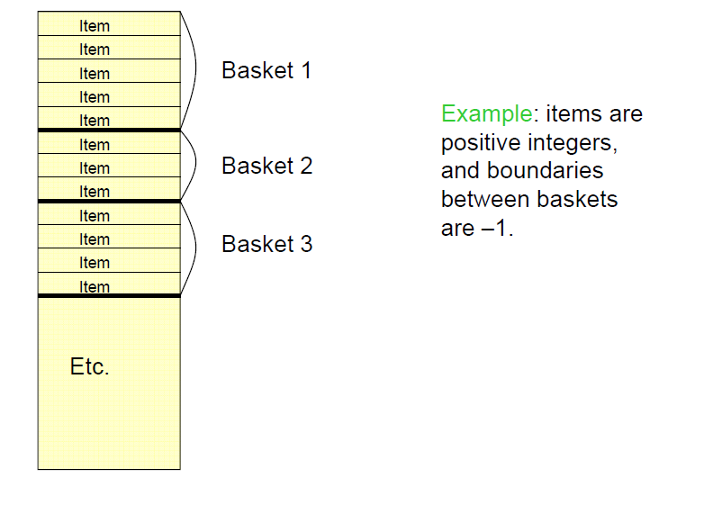
Computation Model
Typically, data is kept in flat files and stored on disk
The true cost of mining disk-resident data is usually the number of disk I/O’s.
In practice, association-rule algorithms read the data in passes – all itemsets read in turn.
Thus, we measure the cost by the number of passes an algorithm takes.

Slide 16
Apriori Algorithm
Apriori property: any subset of a frequent itemset must be frequent
if {cereal, diaper, nuts} is frequent, so is {cereal, diaper}
Every transaction having {cereal, diaper, nuts} also contains {cereal, diaper}
ABC ABD ACD BCD
AB AC AD BC BD CD
A B C D

Slide 17
Apriori Algorithm
Apriori pruning principle:
If there is any itemset which is infrequent, its superset should not be generated/tested!
Method:
generate length (k+1) candidate itemsets from length k frequent itemsets, and
test the candidates against DB
Performance studies show its efficiency and scalability
Agrawal & Srikant 1994, Mannila, et al. 1994
Notes:
If an itemset is not frequent, then all of its supersets cannot be frequent
The support of an itemset never exceeds the support of its subsets
This is known as the anti-monotone property of support

Slide 18
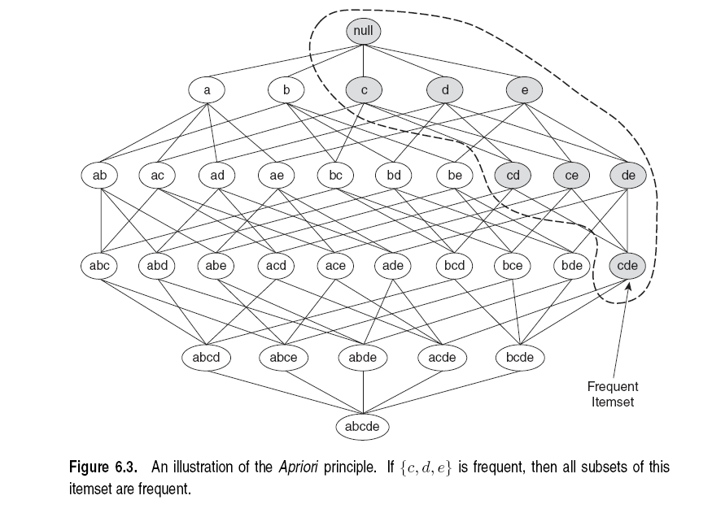
Illustration of the Apriori principle
Frequent subsets
Found to be frequent

Slide 19
Illustration of the Apriori principle
Found to be Infrequent
Infrequent supersets
Pruned

Slide 20
The Apriori algorithm
C_{k} = candidate itemsets of size k
L_{k} = frequent itemsets of size k
Level-wise approach
k = 1, C₁ = all items
While C_{k} not empty
Scan the database to find which itemsets in C_{k} are frequent and put them into L_{k}
Use L_{k} to generate a collection of candidate itemsets C_{k+1} of size k+1‏
k = k+1
Frequent itemset generation
Candidate generation
R. Agrawal, R. Srikant: "Fast Algorithms for Mining Association Rules",
Proc. of the 20th Int'l Conference on Very Large Databases, 1994.

Slide 21
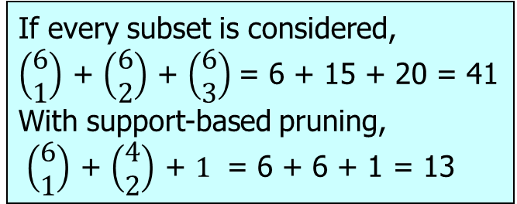
Illustration of the Apriori principle
minsup = 3
Items (1-itemsets)‏
Pairs (2-itemsets)‏
(No need to generate candidates involving Coke or Eggs)‏
Triplets (3-itemsets)‏
If every subset is considered,
$\left(\begin{matrix}6 \\ 1\end{matrix}\right)$ + $\left(\begin{matrix}6 \\ 2\end{matrix}\right)$ + $\left(\begin{matrix}6 \\ 3\end{matrix}\right)$= 6 + 15 + 20 = 41
With support-based pruning,
$\left(\begin{matrix}6 \\ 1\end{matrix}\right)$ + $\left(\begin{matrix}4 \\ 2\end{matrix}\right)$ + $1$ = 6 + 6 + 1 = 13
Only this triplet has all subsets to be frequent
But it is below the minsup threshold

Slide 22
Candidate Generation
Basic principle (Apriori):
An itemset of size k+1 is candidate to be frequent only if all of its subsets of size k are known to be frequent
Main idea:
Construct a candidate of size k+1 by combining frequent itemsets of size k
If k = 1, take the all pairs of frequent items
If k > 1, join pairs of itemsets that differ by just one item
For each generated candidate itemset ensure that all subsets of size k are frequent.

Slide 23
The Apriori Algorithm—An Example
Itemset | sup
{A} | 2
{B} | 3
{C} | 3
{D} | 1
{E} | 3
Database TDB
Itemset | sup
{A} | 2
{B} | 3
{C} | 3
{E} | 3
L₁
Tid | Items
10 | A, C, D
20 | B, C, E
30 | A, B, C, E
40 | B, E
C₁
1st scan
C₂
Itemset | sup
{A, B} | 1
{A, C} | 2
{A, E} | 1
{B, C} | 2
{B, E} | 3
{C, E} | 2
C₂
Itemset
{A, B}
{A, C}
{A, E}
{B, C}
{B, E}
{C, E}
L₂
Itemset | sup
{A, C} | 2
{B, C} | 2
{B, E} | 3
{C, E} | 2
2nd scan
C₃
Itemset
{B, C, E}
3rd scan
L₃
Itemset | sup
{B, C, E} | 2

Slide 24
The Apriori Algorithm—An Example
L₁
L₂
L₃
Itemset | sup
{A} | 2
{B} | 3
{C} | 3
{E} | 3
Itemset | sup
{A, C} | 2
{B, C} | 2
{B, E} | 3
{C, E} | 2
Itemset | sup
{B, C, E} | 2
All Rules
A → C , C → A
B →C, C → B
B → E, E → B
BC → E
CE → B
BE → C
Frequency ≥ 50%,
Confidence 100%:
A → C
B → E, E → B
BC → E
CE → B

Slide 25
Apriori Algorithm
Pseudo-code:
C_{k}: Candidate itemset of size k
L_{k} : frequent itemset of size k
L₁ = {frequent items};
for (k = 1; L_{k} !=∅; k++) do begin
C_{k+1} = candidates generated from L_{k};
for each transaction t in database do
increment the count of all candidates in C_{k+1} that are
contained in t
L_{k+1} = candidates in C_{k+1} with min_support
end
return L = ∪_{k} L_{k};

Slide 26
Generate Candidates C_{k+1}
Assumption: The items in an itemset are ordered
E.g., if integers ordered in increasing order, if strings ordered in lexicographic order
The order ensures that if item y > x appears before x, then x is not in the itemset
The items in L_{k} are also listed in an order
Create a candidate itemset of size k+1, by joining two itemsets of size k, that share the first k-1 items
Item 1 | Item 2 | Item 3
1 | 2 | 3
1 | 2 | 5
1 | 4 | 5

Slide 27
Generate Candidates C_{k+1}
Assumption: The items in an itemset are ordered
E.g., if integers ordered in increasing order, if strings ordered in lexicographic order
The order ensures that if item y > x appears before x, then x is not in the itemset
The items in L_{k} are also listed in an order
Create a candidate itemset of size k+1, by joining two itemsets of size k, that share the first k-1 items
Item 1 | Item 2 | Item 3
1 | 2 | 3
1 | 2 | 5
1 | 4 | 5
1 | 2 | 3 | 5

Slide 28
Generate Candidates C_{k+1}
Assumption: The items in an itemset are ordered
E.g., if integers ordered in increasing order, if strings ordered in lexicographic order
The order ensures that if item y > x appears before x, then x is not in the itemset
The items in L_{k} are also listed in an order
Create a candidate itemset of size k+1, by joining two itemsets of size k, that share the first k-1 items
Item 1 | Item 2 | Item 3
1 | 2 | 3
1 | 2 | 5
1 | 4 | 5
Are we missing something?
What about this candidate?
1 | 2 | 4 | 5
Notes:
Its subset 124 is not frequent so no need to consider this

Slide 29
Generating Candidates C_{k+1} in SQL
self-join L_{k} ‏
insert into C_{k+1}
select p.item₁, p.item₂, …, p.item_{k}, q.item_{k}
from L_{k} p, L_{k} q
where p.item₁=q.item₁, …, p.item_{k-1}=q.item_{k-1}, p.item_{k} < q.item_{k}

Slide 30
Example I
L₃={abc, abd, acd, ace, bcd}
Self-join: L₃*L₃
abcd from abc and abd
acde from acd and ace
item1 | item2 | item3
a | b | c
a | b | d
a | c | d
a | c | e
b | c | d
item1 | Item2 | item3
a | b | c
a | b | d
a | c | d
a | c | e
b | c | d
p.item₁=q.item₁,p.item₂=q.item₂, p.item₃< q.item₃

Slide 31
Example I
L₃={abc, abd, acd, ace, bcd}
Self-joining: L₃*L₃
abcd from abc and abd
acde from acd and ace
item1 | item2 | item3
a | b | c
a | b | d
a | c | d
a | c | e
b | c | d
item1 | item2 | item3
a | b | c
a | b | d
a | c | d
a | c | e
b | c | d
p.item₁=q.item₁,p.item₂=q.item₂, p.item₃< q.item₃
Notes:
31

Slide 32
Example I
L₃={abc, abd, acd, ace, bcd}
Self-joining: L₃*L₃
abcd from abc and abd
acde from acd and ace
item1 | item2 | item3
a | b | c
a | b | d
a | c | d
a | c | e
b | c | d
item1 | item2 | item3
a | b | c
a | b | d
a | c | d
a | c | e
b | c | d
{a,b,c}
{a,b,d}
{a,b,c,d}
p.item₁=q.item₁,p.item₂=q.item₂, p.item₃< q.item₃
Notes:
32

Slide 33
Example I
L₃={abc, abd, acd, ace, bcd}
Self-joining: L₃*L₃
abcd from abc and abd
acde from acd and ace
item1 | item2 | item3
a | b | c
a | b | d
a | c | d
a | c | e
b | c | d
item1 | item2 | item3
a | b | c
a | b | d
a | c | d
a | c | e
b | c | d
{a,c,d}
{a,c,e}
{a,c,d,e}
p.item₁=q.item₁,p.item₂=q.item₂, p.item₃< q.item₃
Notes:
33

Slide 34
Generate Candidates C_{k+1}
Are we done? Are all the candidates valid?
Pruning step:
For each candidate (k+1)-itemset create all subset k-itemsets
Remove a candidate if it contains a subset k-itemset that is not frequent
Item 1 | Item 2 | Item 3
1 | 2 | 3
1 | 2 | 5
1 | 4 | 5
1 | 2 | 3 | 5
Is this a valid candidate?
No. Subsets (1,3,5) and (2,3,5) should also be frequent
Apriori principle

Slide 35
Example I
{a,b,c}
{a,b,d}
L₃={abc, abd, acd, ace, bcd}
Self-joining: L₃*L₃
abcd from abc and abd
acde from acd and ace
Pruning:
abcd is kept since all subset itemsets are in L₃
acde is removed because ade is not in L₃
C₄={abcd}
{a,b,c,d}
abc
abd
acd
bcd
√
√
√
√
{a,c,d}
{a,c,e}
{a,c,d,e}
acd
ace
ade
cde
√
√
X

Slide 36
Generate Candidates C_{k+1}
We have all frequent k-itemsets L_{k}
Step 1: self-join L_{k}‏
Create set C_{k+1} by joining frequent k-itemsets that share the first k-1 items
Step 2: prune
Remove from C_{k+1} the itemsets that contain a subset k-itemset that is not frequent

Slide 37
Apriori Example
Minimum support count is 2.

Slide 38
Apriori Example

Slide 39
Apriori Example

Slide 40
How to Count Supports of Candidates?
Why counting supports of candidates a problem?
The total number of candidates can be very huge
One transaction may contain many candidates
Method:
Candidate itemsets are stored in a hash-tree
Leaf node of hash-tree contains a list of itemsets and counts
Interior node contains a hash table
Subset function: finds all the candidates contained in a transaction
Notes:
We can skip this …….hashing slides

Slide 41
Computing Frequent Itemsets
Given the set of candidate itemsets C_{k}, we need to compute the support and find the frequent itemsets L_{k}.
Scan the data, and use a hash structure to keep a counter for each candidate itemset that appears in the data
C_{k}

Slide 42
A simple hash structure
Create a dictionary (hash table) that stores the candidate itemsets as keys, and the number of appearances as the value.
Increment the counter for each itemset that you see

Slide 43
Example
Key | Value
{3 6 7} | 1
{3 4 5} | 1
{1 3 6} | 3
{1 4 5} | 5
{2 3 4} | 2
{1 5 9} | 1
{3 6 8} | 1
{4 5 7} | 2
{6 8 9} | 1
{5 6 7} | 3
{1 2 4} | 8
{3 5 7} | 1
{1 2 5} | 0
{3 5 6} | 1
{4 5 8} | 1
Suppose you have 15 candidate itemsets of length 3:
{1 4 5}, {1 2 4}, {4 5 7}, {1 2 5}, {4 5 8},
{1 5 9}, {1 3 6}, {2 3 4}, {5 6 7}, {3 4 5},
{3 5 6}, {3 5 7}, {6 8 9}, {3 6 7}, {3 6 8}
Hash table stores the counts of the candidate itemsets as they have been computed so far
Notes:
Some can be zero…. As these are generated from 2 –itemsets and we are finding their count in the DB---
So it will be the one whose two itemsets are frequent and up-till now it is not found in the DB

Slide 44
Apriori: Implementation Using Hash Tree
Suppose you have 15 candidate itemsets of length 3:
{1 4 5}, {1 2 4}, {4 5 7}, {1 2 5}, {4 5 8}, {1 5 9}, {1 3 6}, {2 3 4}, {5 6 7}, {3 4 5}, {3 5 6}, {3 5 7}, {6 8 9}, {3 6 7}, {3 6 8}
You need:
Hash function
Max leaf size: max number of itemsets stored in a leaf node
(if number of candidate itemsets exceeds max leaf size, split the node)
Hash function
3,6,9
1,4,7
2,5,8

Slide 45
Subset Generation
Given a transaction t, what are the possible subsets of size 3?
Recursion!

Slide 46
Example
Key | Value
{3 6 7} | 1
{3 4 5} | 1
{1 3 6} | 3
{1 4 5} | 5
{2 3 4} | 2
{1 5 9} | 1
{3 6 8} | 1
{4 5 7} | 2
{6 8 9} | 1
{5 6 7} | 3
{1 2 4} | 8
{3 5 7} | 1
{1 2 5} | 0
{3 5 6} | 1
{4 5 8} | 1
Tuple {1,2,3,5,6} generates the following itemsets of length 3:
{1 2 3}, {1 2 5}, {1 2 6}, {1 3 5}, {1 3 6},
{1 5 6}, {2 3 5}, {2 3 6}, {3 5 6},
Increment the counters for the itemsets in the dictionary

Slide 47
Example
Key | Value
{3 6 7} | 1
{3 4 5} | 1
{1 3 6} | 4
{1 4 5} | 5
{2 3 4} | 2
{1 5 9} | 1
{3 6 8} | 1
{4 5 7} | 2
{6 8 9} | 1
{5 6 7} | 3
{1 2 4} | 8
{3 5 7} | 1
{1 2 5} | 1
{3 5 6} | 2
{4 5 8} | 1
Tuple {1,2,3,5,6} generates the following itemsets of length 3:
{1 2 3}, {1 2 5}, {1 2 6}, {1 3 5}, {1 3 6},
{1 5 6}, {2 3 5}, {2 3 6}, {3 5 6},
Increment the counters for the itemsets in the dictionary

Slide 48
Subset Operation Using Hash Tree
1 2 3 5 6
transaction
Hash Function
1 +
2 3 5 6
2 +
3 5 6
3 +
5 6
1,4,7
2,5,8
3,6,9
2 3 4
5 6 7
1 4 5
1 3 6
3 4 5
3 5 6
3 6 7
3 5 7
3 6 8
1 2 4
1 2 5
1 5 9
6 8 9
4 5 7
4 5 8

Slide 49
Subset Operation Using Hash Tree
1 2 3 5 6
transaction
Hash Function
1 +
2 3 5 6
2 +
3 5 6
1 2 +
3 5 6
3 +
5 6
1,4,7
2,5,8
3,6,9
1 3 +
5 6
2 3 4
1 5 +
6
5 6 7
1 4 5
1 3 6
3 4 5
3 5 6
3 6 7
3 5 7
3 6 8
1 2 4
1 2 5
1 5 9
6 8 9
4 5 7
4 5 8

Slide 50
Subset Operation Using Hash Tree
1 2 3 5 6
transaction
Hash Function
1 +
2 3 5 6
2 +
3 5 6
1 2 +
3 5 6
3 +
5 6
3,6,9
1,4,7
2,5,8
1 3 +
5 6
2 3 4
1 5 +
6
5 6 7
Increment the counters
1 4 5
1 3 6
3 4 5
3 5 6
3 6 7
3 5 7
3 6 8
1 2 4
1 2 5
1 5 9
6 8 9
4 5 7
4 5 8
Match transaction against 9 out of 15 candidates
Hash-tree enables to enumerate itemsets in transaction
and match them against candidates
Notes:
Itemset that are not in the dictionary indicate they are not frequent so ignore them

Slide 51
Count
the items
All pairs
of items
from L₁
Count
the pairs
All
items
Filter
Construct
Filter
Construct
C₁
L₁
C₂
L₂
C₃
First
pass
Second
pass
Frequent
items
Frequent
pairs

Slide 52
Association Rule Mining Task
Input: A set of transactions T, over a set of items I
Output: All rules with items in I having
support ≥ minsup threshold
confidence ≥ minconf threshold
From Book ‘Introduction to Data Mining’

Slide 53
Mining Association Rules
Two-step approach:
Frequent Itemset Generation
Generate all itemsets whose support ≥ minsup
Rule Generation
Generate high confidence rules from each frequent itemset, where each rule is a partitioning of a frequent itemset into Left-Hand-Side (LHS) and Right-Hand-Side (RHS)
Frequent itemset: {A,B,C,D}
Rule: AB→CD

Slide 54
Rule Generation
We have all frequent itemsets, how do we get the rules?
For every frequent itemset S, we find rules of the form L→S – L, where L ⊂ S, that satisfy the minimum confidence requirement
Example: L = {A,B,C,D}
Candidate rules:
A →BCD, B →ACD, C →ABD, D →ABC AB →CD, AC → BD, AD → BC, BD →AC, CD →AB, ABC →D, BCD →A, BC →AD,
If |L| = k, then there are 2^{k} – 2 candidate association rules (ignoring L → ∅ and ∅ → L)

Slide 55
Rule Generation
How to efficiently generate rules from frequent itemsets?
In general, confidence does not have an anti-monotone property
c(ABC →D) can be larger or smaller than c(AB →D)
But confidence of rules generated from the same itemset has an anti-monotone property
e.g., L = {A,B,C,D}: c(ABC → D) ≥ c(AB → CD) ≥ c(A → BCD)
Confidence is anti-monotone w.r.t. number of items on the RHS of the rule
Notes:
c(ABC →D) = s(ABCD)/s(ABC) …… c(AB →D)= = s(ABCD)/s(AB)
s(ABCD)/s(ABC) >= s(ABCD)/s(AB) >= s(ABCD)/s(A)
Note entity that is dividing is equal or have higher value

Slide 56
Rule Generation for Apriori Algorithm
Low Confidence Rule
Pruned Rules
Lattice of rules created by the RHS
Notes:
c(A->B) = P(B|A) = P(AUB)/P(A)= s(AB)/s(A)
c(BCD -> A) = support count(ABCD) / support count (BCD)
C(CD->AB) = s(ABCD)/s(CD)

Slide 57
Rule Generation for Apriori Algorithm
Candidate rule is generated by merging two rules that share the same prefix in the RHS
join(AD→BC,AC→BD) would produce the candidate rule A → BCD
Prune rule A → BCD if its subset AB→CD does not have high confidence
Essentially we are doing Apriori on the RHS
AD→BC
AC→BD
A → BCD
Notes:
From Introduction to Data Mining book
1.First generate all rules with single item on right hand side BCD-> A, ACD->B, ABD-> C, ABC-> D …if confidence is < c prune the rule
2. Generate all rules with 2 –item on right hand side using above rules (use apriori principle self-join and prune if subset is not frequent)
So we get all rules with two items on right hand side …let say BCD-> A confidence is less prune it
And generate rules such that AD->BC , AC-> BD , AB->CD
3. Generate A-> BCD as above

Slide 58
Challenges of Frequent Pattern Mining
Challenges
Multiple scans of transaction database
Huge number of candidates
Tedious workload of support counting for candidates

Slide 59
Improving Apriori: general ideas
Reduce passes of transaction database scans
Reduce the number of candidates (M)
Complete search: M=2^{d}
Use pruning techniques to reduce M
Reduce the number of transactions (N)
Reduce size of N as the size of itemset increases
Used by DHP and vertical-based mining algorithms
Reduce the number of comparisons (NM)
Use efficient data structures to store the candidates or transactions
No need to match every candidate against every transaction

Slide 60
DIC: Reduce Number of Scans
ABCD
Once both A and D are determined frequent, the counting of AD begins
Once all length-2 subsets of BCD are determined frequent, the counting of BCD begins
ABC
ABD
ACD
BCD
AB
AC
BC
AD
BD
CD
Transactions
1-itemsets
A
B
C
D
Apriori
2-itemsets
…
{}
Itemset lattice
1-itemsets
2-items
S. Brin R. Motwani, J. Ullman, and S. Tsur. Dynamic itemset counting and implication rules for market basket data. In SIGMOD’97
DIC
3-items
Notes:
DIC= Dynamic Itemset counting

Slide 61
Apriori vs. DIC
Apriori
level-wise
many passes
DIC
reduce the number of passes
fewer candidate itemsets than sampling
example : 40,000 transaction, M = 10,000

Slide 62
DIC - Counting large itemsets
Itemsets : a large lattice
count just the minimal small itemsets
the itemsets that do not include any other small itemsets
mark itemset
Solid box - confirmed large itemset
Solid circle - confirmed small itemset
Dashed box - suspected large itemset
Dashed circle - suspected small itemset

Slide 63
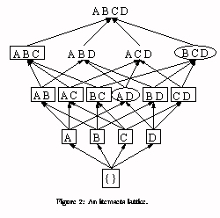
Fig 2. An itemsets lattice

Slide 64
DIC algorithm
The empty itemset is marked with a soild box. All the 1-itemsets are marked with dashed circles. All other itemsets are unmarked.
Read M transactions. For each transaction, increment the respective counters for the itemsets marked with dashes.
If a dashed circle has a count that exceeds the support threshold, turn it into a dashed square. If any immediate superset of it has all of its subsets as solid or dashed squares, add new counter for it and make it dashed circle.
If a dashed itemset has been counted through all the transactions, make it solid and stop counting it.
If we are at the end of the transaction file, rewind to the beginning
If any dashed itemsets remain, go to step 2.

Slide 65
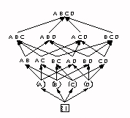
Fig 3. Start of DIC algorithm

Slide 66
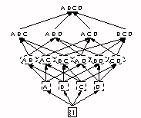
Fig 4. After M transactions

Slide 67
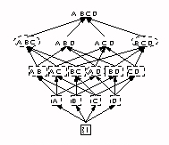
Fig 5. After 2M transactions

Slide 68
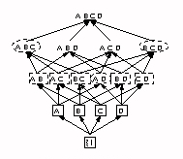
Fig 6. After one pass

Slide 69
DIC- Data structure
like the hash tree used in Apriori with a little extra information
Every node stores
the last item in the itemset
counter, marker, its state
its branches if it is an interior node

Slide 70
DIC- Implication rules
conviction
more useful and intuitive measure
unlike confidence,
normalized based on both the antecedent and the consequent
unlike interest,
directional
actual implication as opposed to co-occurrence
support : P(A, B)
confidence : P(B|A) = P(A, B)/P(A)
interest : P(A, B)/P(A)P(B)
conviction : P(A)P(¬B)/P(A, ¬B)

Slide 71
Reducing Number of Candidates
Apriori principle:
If an itemset is frequent, then all of its subsets must also be frequent
Apriori principle holds due to the following property of the support measure:
Support of an itemset never exceeds the support of its subsets
This is known as the anti-monotone property of support

Slide 72
DHP: Reduce the Number of Candidates
A hash table technique is used to reduce the size of the candidate k-itemsets.
When scanning each transaction for 1-itemset in C1,
we can generate all of the 2-itemset of each T and
hash them into different buckets of a hash table and increase the corresponding bucket count
A k-itemset whose corresponding hashing bucket count is below the threshold cannot be frequent
J. Park, M. Chen, and P. Yu. An effective hash-based algorithm for mining association rules. SIGMOD’95
If the minimum support count = 3, then the itemsets in buckets 0, 1, 3, and 4 cannot be frequent and so they should not be included in C2.
Notes:
Figure 6.5: Hash table, H2, for candidate 2-itemsets: This hash table was
generated by scanning the transactions of Table 6.1 while determining L1. If
the minimum support count is, say, 3, then the itemsets in buckets 0, 1, 3, and
4 cannot be frequent and so they should not be included in C2.
the database to generate the frequent 1-itemsets, L1, we can generate all of
the 2-itemsets for each transaction, hash (i.e., map) them into the different
buckets of a hash table structure, and increase the corresponding bucket
counts (Figure 6.5). A 2-itemset whose corresponding bucket count in the
hash table is below the support threshold cannot be frequent and thus
should be removed from the candidate set. Such a hash-based technique
may substantially reduce the number of the candidate k-itemsets examined
(especially when k = 2).
Processing cost of initial list is very huge so they try to reduce the size of db t initial stages

Slide 73
ECLAT (vertical format)
For each item, store a list of transaction ids (tids)
Notes:
Deriving frequent patterns based on vertical intersections
t(X) = t(Y): X and Y always happen together
t(X) ⊂ t(Y): transaction having X always has Y
Using diffset to accelerate mining
Only keep track of differences of tids
t(X) = {T₁, T₂, T₃}, t(XY) = {T₁, T₃}
Diffset (XY, X) = {T₂}

Slide 74
ECLAT
Determine support of any k-itemset by intersecting tid-lists of two of its (k-1) subsets.
Advantage: very fast support counting
Disadvantage: intermediate tid-lists may become too large for memory
Using diffset to accelerate mining
Only keep track of differences of tids
T(B) = {1,2,5,7,8,10}, T(AB) = {1,5,7,8} , Diff_Set (AB, B) = {2,10}
M. Zaki et al. New algorithms for fast discovery of association rules. in KDD’97
Notes:
Diffset can speed up things if the transaction are very dense
M. Zaki et al. New algorithms for fast discovery of association rules. In KDD’97
P. Shenoy et al. Turbo-charging vertical mining of large databases. In SIGMOD’00

Slide 75
The Partitioning Algorithm
Divide database into n partitions.
so that each portion can fit into memory.
Any itemset that is frequent in DB must be frequent in at least one of the n partitions (pigeon hole principle)
Require 2 DB Scans
Scan 1: partition database and find local frequent patterns
Scan 2: consolidate global frequent patterns
DB₁
+
DB₂
+
+
DB_{k}
= DB
sup₁(i) < σDB₁
sup₂(i) < σDB₂
sup_{k}(i) < σDB_{k}
sup(i) < σDB
Notes:
A. Savasere, E. Omiecinski and S. Navathe, VLDB’95

Slide 76
The Partitioning Algorithm
Process one partition in main memory at a time:
For each partition, generate frequent itemsets using the Apriori algorithm
min_support for a partition = min_support of DB x no of transactions in that partition (here min_support is in %)
Form Tidlist for all item sets to facilitate counting in the merge phase
After all partitions are processed, the local frequent itemsets are merged into global frequent sets
support can be computed from the tidlists.
Partition (Savasere, Omiecinski, & Navathe, VLDB’95).
Notes:
The set of transactions may be divided into a number of disjoint subsets. Then each partition is searched for frequent itemsets. These frequent itemsets are called local frequent itemsets.
How can information about local itemsets be used in finding frequent itemsets of the global set of transactions?
Total transaction = 100
Create 5 partitions ..each partition will have 20 transactions
Min support is let say 50% … 50 transactions
Min support for a partition = 50% * 20 = 10

Slide 77
Is Apriori Fast Enough? — Performance Bottlenecks
The bottleneck of Apriori: candidate generation
Breadth-first (i.e., level-wise) search
Huge candidate sets:
10⁴ frequent 1-itemset will generate 10⁷ candidate 2-itemsets
To discover a frequent pattern of size 100, e.g., {a₁, a₂, …, a₁₀₀}, one needs to generate 2¹⁰⁰ ≈ 10³⁰ candidates.
Multiple scans of database:
Needs n or (n +1 ) scans, n is the length of the longest pattern
Notes:
The core of the Apriori algorithm:
Use frequent (k – 1)-itemsets to generate candidate frequent k-itemsets
Use database scan and pattern matching to collect counts for the candidate itemsets
Bottlenecks of the Apriori approach
Breadth-first (i.e., level-wise) search
Candidate generation and test
Often generates a huge number of candidates

Slide 78
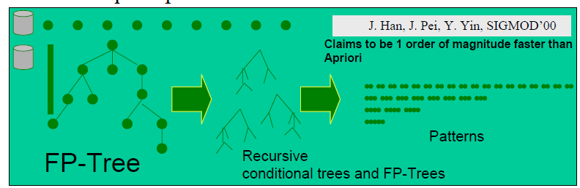
Frequent Pattern Growth (FP)
First algorithm that allows frequent pattern mining without generating candidate sets
Grow long patterns from short ones using local frequent items
“ab” is a frequent pattern
Get all transactions having “ab”: DB|ab
“d” is a local frequent item in DB|ab → abd is a frequent pattern

Slide 79
Construct FP-tree from a Transaction Database
TID Items bought (ordered) frequent items
100 {f, a, c, d, g, i, m, p} {f, c, a, m, p}
200 {a, b, c, f, l, m, o} {f, c, a, b, m}
300 {b, f, h, j, o, w} {f, b}
400 {b, c, k, s, p} {c, b, p}
500 {a, f, c, e, l, p, m, n} {f, c, a, m, p}
min_support = 3
{}
Header Table
Item frequency head
f 4
c 4
a 3
b 3
m 3
p 3
Scan DB once, find frequent 1-itemset (single item pattern)
Sort frequent items in frequency descending order, f-list
Scan DB again, construct FP-tree
f:4
c:1
c:3
b:1
b:1
a:3
p:1
m:2
b:1
F-list = f-c-a-b-m-p
p:2
m:1
Notes:
The items are sorted in support-decending order. This indicates more frequent items are closer to the root and are most likely shared. Thus FP-tree structure is highly compact. However, this does not mean that the tree constructed in this manner always achieve max compactness. With the knowledge of the given data once can create a more compact tree
Example given in FP-tree paper
FP-tree is quite compact it may fit in the main memory for even large databses but this is not true for all data sets

Slide 80
Step 1: Construct Conditional Pattern Base
Starting at the frequent item header table in the FP-tree
Traverse the FP-tree by following the link of each frequent item
Accumulate all of transformed prefix paths of that item to form a conditional pattern base
{}
Header Table
Item frequency head
f 4
c 4
a 3
b 3
m 3
p 3
Conditional pattern bases
item cond. pattern base
c f:3
a fc:3
b fca:1, f:1, c:1
m fca:2, fcab:1
p fcam:2, cb:1
f:4
c:1
c:3
b:1
b:1
a:3
p:1
m:2
b:1
p:2
m:1
Notes:
Properties of Step 1
• Node-link property
– For any frequent item ai, all the possible frequent patterns
that contain ai can be obtained by following ai's node-links,
starting from ai's head in the FP-tree header.
• Prefix path property
– To calculate the frequent patterns for a node ai in a path P,
only the prefix sub-path of ai in P need to be accumulated,
and its frequency count should carry the same count as node
ai.

Slide 81
Step 2: Construct Conditional FP-tree
For each pattern-base
Accumulate the count for each item in the base
Construct the conditional FP-tree for the frequent items of the pattern base
m-conditional pattern base:
fca:2, fcab:1
{}
Header Table
Item frequency head
f 4
c 4
a 3
b 3
m 3
p 3
f:4
c:1
{}
c:3
b:1
b:1

f:3
a:3
p:1
c:3
m:2
b:1
a:3
p:2
m:1
m-conditional FP-tree
Notes:
All frequent patterns relate to m
m,
fm, cm, am,
fcm, fam, cam,
fcam

Slide 82
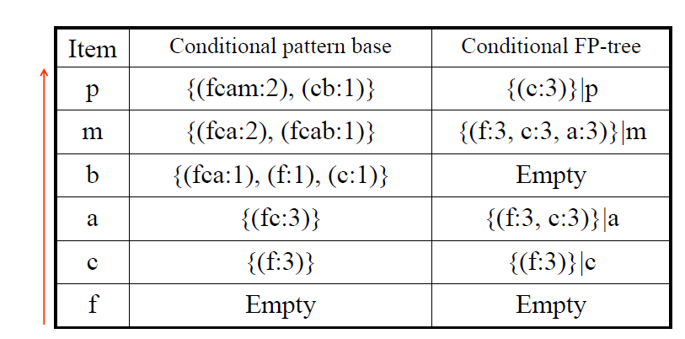
Conditional Pattern Bases and Conditional FP-Tree

Slide 83
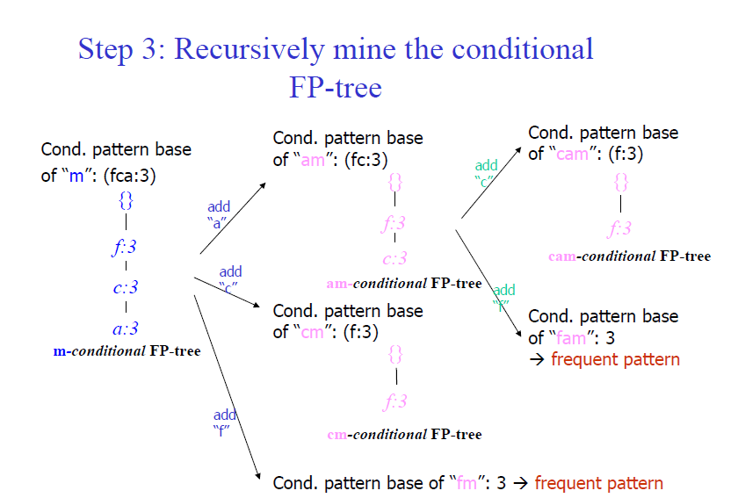

Slide 85
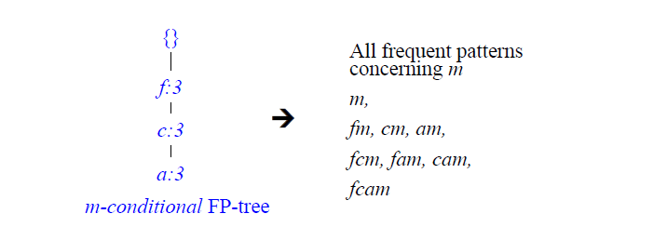
Single FP-tree Path Generation
For single path the frequent patterns can be generated by enumeration of all the combinations of the sub-paths

Slide 86
A Special Case: Single Prefix Path in FP-tree
Suppose a (conditional) FP-tree T has a shared single prefix-path P
Mining can be decomposed into two parts
Reduction of the single prefix path into one node
Concatenation of the mining results of the two parts
{}
a₁:n₁
a₂:n₂
a₃:n₃
{}
r₁
a₁:n₁
+
b₁:m₁
C₁:k₁
r₁
=
b₁:m₁
C₁:k₁

a₂:n₂
C₂:k₂
C₃:k₃
a₃:n₃
C₂:k₂
C₃:k₃

Slide 87
Frequent Pattern Growth Mining Method
Idea: Frequent pattern growth
Recursively grow frequent patterns by pattern and database partition
Method
For each frequent item, construct its conditional pattern-base, and then its conditional FP-tree
Repeat the process on each newly created conditional FP-tree
Until the resulting FP-tree is empty, or it contains only one path—single path will generate all the combinations of its sub-paths, each of which is a frequent pattern

Slide 88
FP-Growth

Slide 89
FP-Tree size
FP-Tree usually has a smaller size than the uncompressed data
Typically many transactions share items (and hence prefixes).
Best case scenario: all transactions contain the same set of items.
1 path in the FP-tree
Worst case scenario: every transaction has a unique set of items (no items in common)
Size of the FP-tree is at least as large as the original data.
Storage requirements for the FP-tree are higher - need to store the pointers between the nodes and the counters.
Notes:
The size of the FP-tree depends on how the items are ordered
Ordering by decreasing support is typically used but it does not always lead to the smallest tree (it's a heuristic).

Slide 90
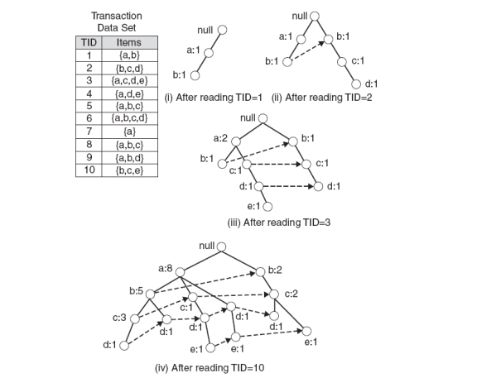
Example 2: FP-Tree Construction

Slide 91
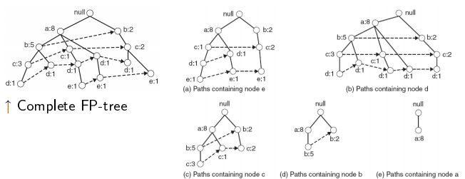
Example 2: Conditional Pattern Base

Slide 92
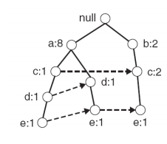
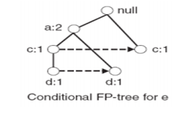
Example 2
Let minSup = 2
Extract all frequent itemsets containing e.
Conditional Pattern base and FP tree for e

Slide 93
Example
Check if e is a frequent item
Add the counts along the linked list (dotted line).
Yes, count =3 so {e} is extracted as a frequent itemset.
As e is frequent, find frequent itemsets ending in e. i.e. de, ce and ae.
Notes:
4. Use the the conditional FP-tree for e to find frequent itemsets ending in de, ce and ae
Note that be is not considered as b is not in the conditional FP-tree for e.
I For each of them (e.g. de), find the prefix paths from the conditional tree for e, extract frequent itemsets, generate conditional FP-tree, etc... (recursive

Slide 94
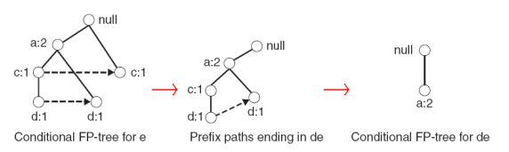
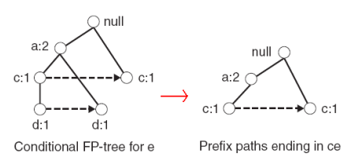
Example
Example: e -> de -> ade ({d,e}, {a,d,e} are found to be frequent)
Example: e -> ce ({c,e} is found to be frequent)

Slide 95
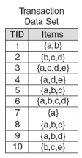
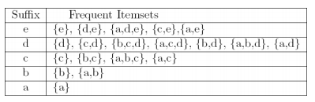
Result
Frequent itemsets found (ordered by sufix and order in which they are found):

Slide 96
Discusion
Advantages of FP-Growth
only 2 passes over data-set
“compresses” data-set
no candidate generation
much faster than Apriori
Disadvantages of FP-Growth
FP-Tree may not fit in memory!!
FP-Tree is expensive to build
Notes:
Completeness
Preserve complete information for frequent pattern mining
Never break a long pattern of any transaction
Compactness
Reduce irrelevant info—infrequent items are gone
Items in frequency descending order: the more frequently occurring, the more likely to be shared
Never be larger than the original database (not count node-links and the count field)

Slide 97
FP-Growth vs. Apriori: Scalability With the Support Threshold
Data set T25I20D10K

Slide 98
Closed Patterns and Max-Patterns
A long pattern contains huge number of sub-patterns,
Example:
{a₁, …, a₁₀} contains (₁₀¹) + (₁₀²) + … + (₁¹₀⁰) = 2¹⁰ – 1 sub-patterns!
{a₁, …, a₁₀₀} contains (₁₀₀¹) + (₁₀₀²) + … + (₁¹₀⁰₀⁰) = 2¹⁰⁰ – 1 = 1.27*10³⁰ sub-patterns!
Solution: Mine Closed patterns and Maximal-patterns
Notes:
Example: {a₁, …, a₁₀₀} contains (₁₀₀¹) + (₁₀₀²) + … + (₁¹₀⁰₀⁰) = 2¹⁰⁰ – 1 = 1.27*10³⁰ sub-patterns!

Slide 99
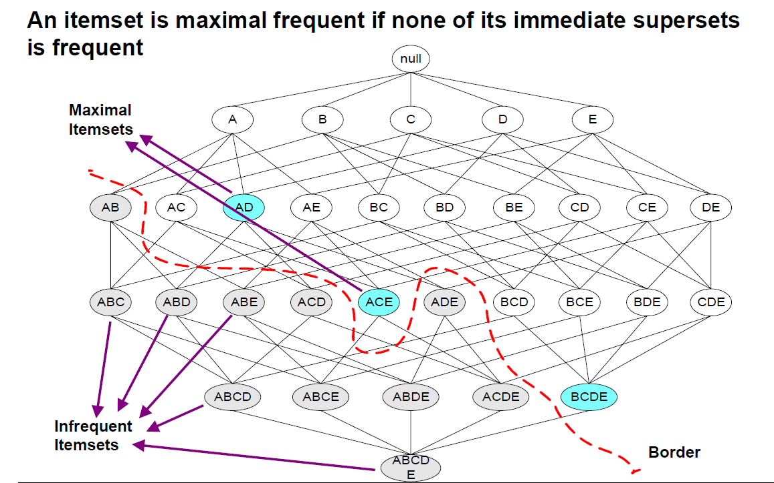
Maximal Frequent Itemset

Slide 100
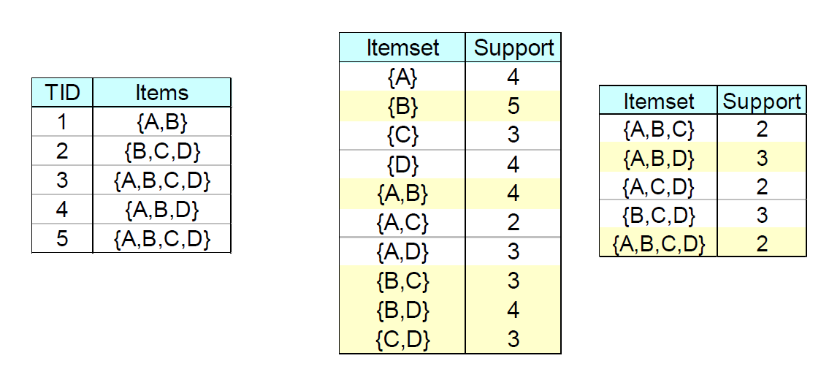
Closed Itemset
An itemset is closed if none of its immediate supersets has the same support as the itemset

Slide 101
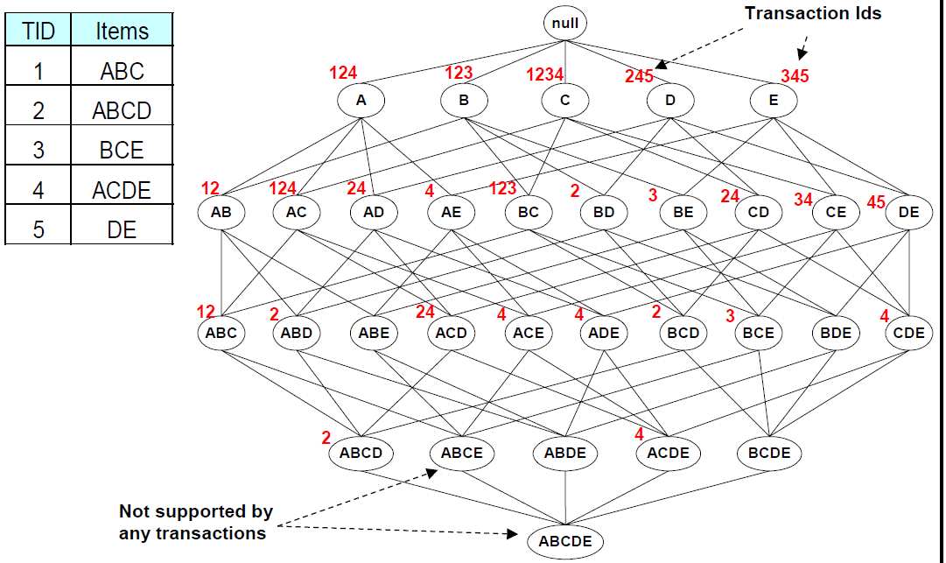
Maximal vs Closed Itemsets

Slide 102
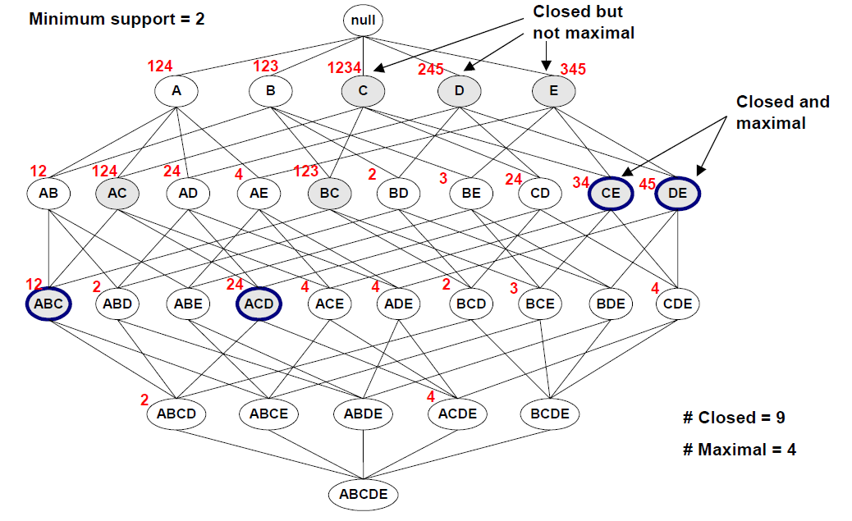
Maximal vs Closed Itemsets

Slide 103
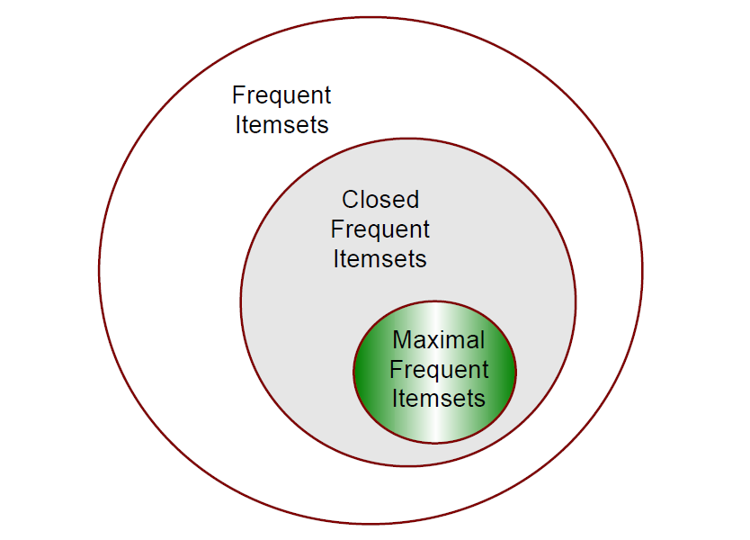
Maximal vs Closed Itemsets
Notes:
Mining Frequent Closed Patterns: CHARM (uses vertical format)

Slide 104
MaxMiner: Mining Max-Patterns
R. Bayardo. Efficiently mining long patterns from databases. SIGMOD’98
Max-Miner algorithm
Efficiently extract only the maximal frequent itemsets
Roughly linear in the number of maximal frequent itemsets
“look ahead” , not bottom-up search
can prune all its subsets from consideration, by identifying a long frequent itemset early on
Notes:
Apriori-like algorithms are inadequate on data-sets with long patterns
a bottom-up search
enumerates every single frequent itemset
exponential complexity
in order to produce a frequent itemset of length l, it must produce all 2^{l} of its subsets since they too must be frequent
restricts Apriori-like algorithms to discovering only short patterns

Slide 105
Complete set-enumeration tree over four items
{ }
1 2 3 4
1,2 1,3 1,4 2,3 2,4 3,4
Set-enumeration tree search frame work
Breadth-first search
to limit the number of passes
Pruning strategies
subset infrequency pruning (as does Apriori)
superset frequency pruning
1,2,3 1,3,4 2,3,4
1,2,3,4

Slide 106
Max-Miner
{ }
1 2 3 4
1,2 1,3 1,4 2,3 2,4 3,4
Candidate group g,
head, h(g)
represents the itemsets enumerated by the node
tail, t(g)
an ordered set
contains all items not in h(g) that can potentially appear in any sub-node
ex. the node enumerating itemset {1}
⇒ h(g) = {1}, t(g) = {2, 3, 4}
1,2,3 1,3,4 2,3,4
1,2,3,4

Slide 107
Max-Miner
{ }
1 2 3 4
1,2 1,3 1,4 2,3 2,4 3,4
counting the support of a candidate group g,
computing the support of itemsets h(g), h(g) ∪ t(g) and h(g) ∪ {i} for all i ∈ t(g)
superset-frequency pruning
halting sub-node expansion at any candidate group g for which h(g) ∪ t(g) is frequent
subset-infrequency pruning
removing any such tail item from candidate group before expanding its sub-nodes
1,2,3 1,3,4 2,3,4
1,2,3,4

Slide 108
Max-Miner
{ }
1 2 3 4
1,2 1,3 1,4 2,3 2,4 3,4
1,2,3 1,3,4 2,3,4
1,2,3,4

Slide 109
CHARM: Mining by Exploring Vertical Data Format
Vertical format: t(AB) = {T₁₁, T₂₅, …}
tid-list: list of trans.-ids containing an itemset
Deriving closed patterns based on vertical intersections
t(X) = t(Y): X and Y always happen together
t(X) ⊂ t(Y): transaction having X always has Y
Using diffset to accelerate mining
Only keep track of differences of tids
t(X) = {T₁, T₂, T₃}, t(XY) = {T₁, T₃}
Diffset (XY, X) = {T₂}
CHARM (Zaki & Hsiao@SDM’02)
Notes:
Eclat/MaxEclat (Zaki et al. @KDD’97), VIPER(P. Shenoy et al.@SIGMOD’00),

Slide 110
Mining Frequent Closed Patterns: CLOSET
Use FP-tree approach
Flist: list of all frequent items in support ascending order
Flist: d-a-f-e-c
Divide search space
Patterns having d
Patterns having d but no a, etc.
Find frequent closed pattern recursively
Every transaction having d also has cfa → cfad is a frequent closed pattern
J. Pei, J. Han & R. Mao. “CLOSET: An Efficient Algorithm for Mining Frequent Closed Itemsets", DMKD'00.
Min_sup=2
TID | Items
10 | a, c, d, e, f
20 | a, b, e
30 | c, e, f
40 | a, c, d, f
50 | c, e, f
Notes:
Itemset merging: if Y appears in every occurrence of X, then Y is merged with X
Sub-itemset pruning: if Y כ X, and sup(X) = sup(Y), X and all of X’s descendants in the set enumeration tree can be pruned
Hybrid tree projection
Bottom-up physical tree-projection
Top-down pseudo tree-projection
Item skipping: if a local frequent item has the same support in several header tables at different levels, one can prune it from the header table at higher levels
Efficient subset checking

Slide 111
The Algorithms (State of the Art)
All
Apriori, FP-Growth, COFI*, ECLAT, Leap
Closed
CHARM, CLOSET+,COFI-CLOSED, Leap
Maximal
MaxMiner, MAFIA, GENMAX, COFI-MAX, Leap

Slide 112
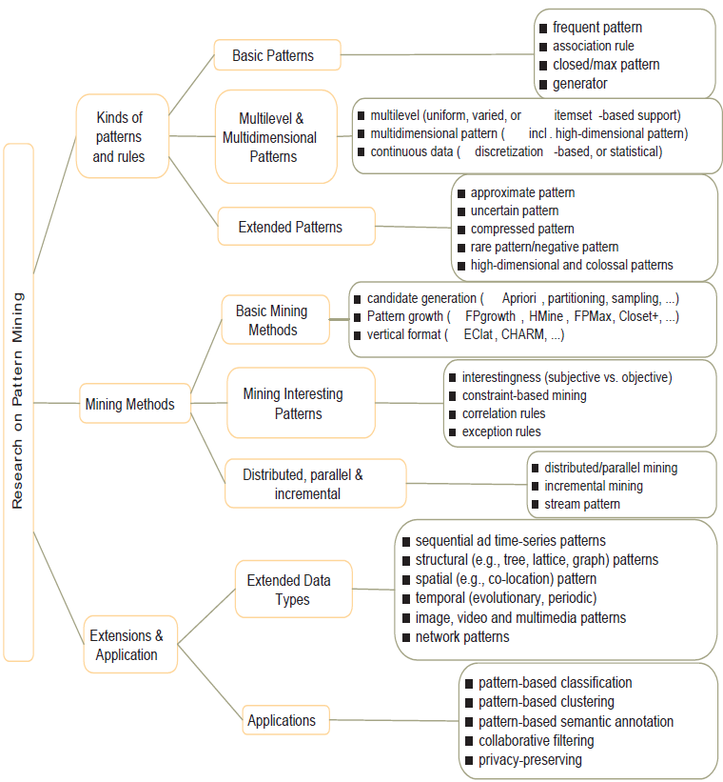

Slide 113
Performance Evaluation of Algorithms
The FP-growth method was usually better than the best implementation of the Apriori algorithm.
Apriori was generally better than other algorithms if the support required was high
since high support leads to a smaller number of frequent items which suits the Apriori algorithm.
At very low support, the number of frequent items became large and none of the algorithms were able to handle large frequent sets gracefully.
Notes:
CHARM was also usually better than Apriori. In some cases, Charm was better than the FP-growth method.

Slide 114
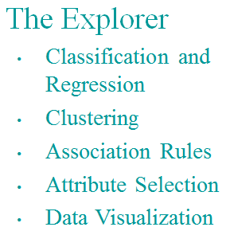
WEKA: A Machine Leaning Toolkit

Slide 115
